Slide 1


Welcome you all
Memory Management
DAY : 1
D.Sakthivel
Assistant Professor & Trainer,
KGiSL Micro College
KGiSL Campus, Coimbatore – 641 035.

Slide 2
Day 1
Introduction
Memory Allocation
Fragmentation
Paging
Virtual Memory
Page Replacement Algorithm
LRU Algorithm
LFU Algorithm

Slide 3
Memory Management
Allocates physical memory to processes
Tracks of allocated and available memory locations
Manages Virtual Memory, etc
Terminology
o The terms Primary Memory, Main Memory & Physical Memory refer to RAM
o Secondary Memory refers to storage devices, such as hard drives and solid state drives.

Slide 4
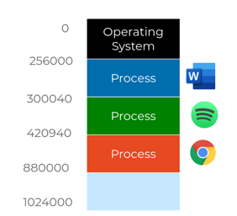
Memory Allocation
· Ensure that each process can only access the address space allocated to it
· Restrict access to address space outside its allocated space

Slide 5
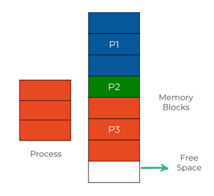
Memory Allocation
·
A single contiguous section of memory blocks is assigned to the process according to its requirement.
Memory is also allocated as blocks of fixed sizes.

Slide 6
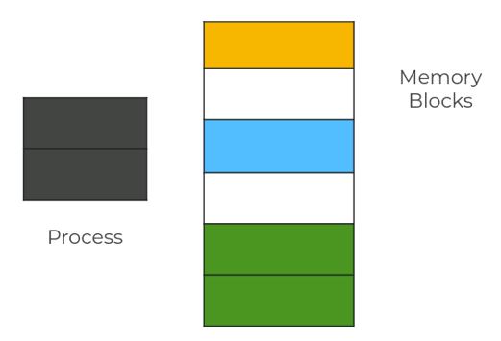
Fragmentation Memory is used inefficiently, reducing capacity & performance. Types of Fragmentation:

Slide 7
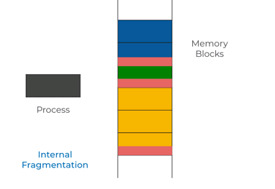
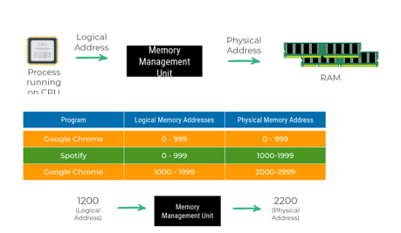
The run time mapping between Virtual address and Physical Address is done by hardware device known as MMU.

Slide 8
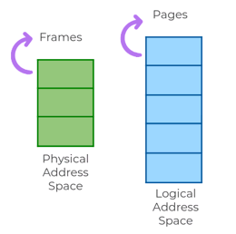
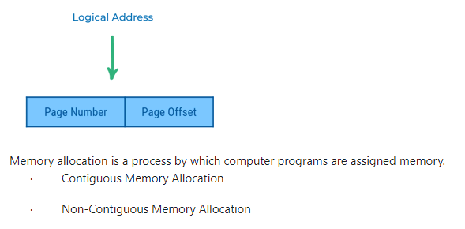
Paging The generated logical address can be broken into two parts
Page Number
Page OffseT
Consider Page Size of 1000 bytes, Logical Address Location 4020 = Page 4, Offset 20

Slide 9
Contiguous Memory Allocation
o External Fragmentation
o Internal Fragmentation
External Fragmentation
Total memory space is enough to satisfy a request, but cannot be used as it is not contiguous.
Internal Fragmentation
Process is allocated a memory block of size more than the size of that process. Due to this some part of the memory is left unused and this cause internal fragmentation.

Slide 10
Non-Contigous Memory Allocation
Assigns different blocks of memory in a non consecutive manner to a process.
· Paging
· Segmentation
Memory Management Unit
· Logical Memory is divided into equal fixed size partitions called pages.
· Each of this pages corresponds to a frame in physical memory.

Slide 11
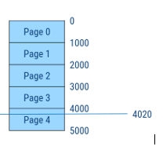
Logical Address
Different parts of the same process can be stored at different places in the main memory.
Page Table
· Maps the page number referenced by the CPU to the frame number where that page is stored.
· Each process has its own independent page table.

Slide 12
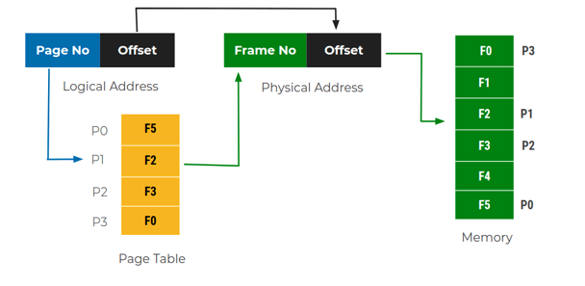
Paging
· Frame number specifies the specific frame where the required page is stored.
· Page Offset specifies the specific word that has to be read from that page

Slide 13
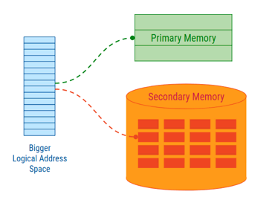
Virtual Memory
· Virtual memory is a memory management technique that creates an illusion to users of larger physical memory.
· Ability to execute partially-loaded program.
· When using virtual memory, logical address is also referred as virtual address.
· The secondary memory used is also referred to as swap space.

Slide 14
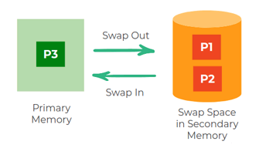
Swapping
Moving memory of a process between Primary Memory and Secondary Memory is called Swapping
· Swap In the currently executing process
· Swap Out the least required process

Slide 15
Demand Paging
· Pages are loaded only on demand, not in advance.
· Page referred for the first time in the main memory, then that page will be found in the secondary memory.

Slide 16
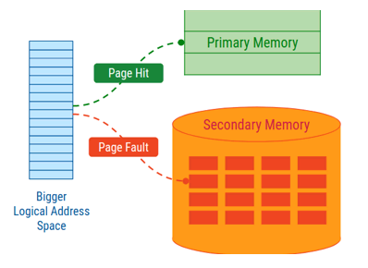
Page Replacement Algorithm
Page replacement algorithm decides which page to remove when a new page needs to be loaded into the primary memory.
Page Replacement Algorithms :
· Least Recently Used (LRU)
· Least Frequently Used (LFU)
and many more...
· If a process requests for page and that page is found in the main memory then it is called page hit.
· If page is not found in memory then it is page miss or page fault.

Slide 17
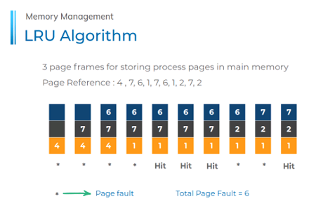
LRU Algorithm
· Least Recently Used (LRU) page.
· It replaces the page that has not been used for the longest period of time.

Slide 18
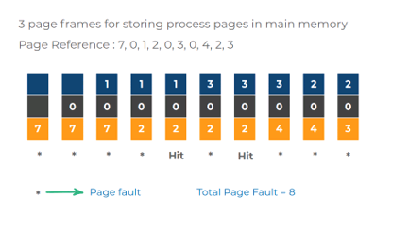
LFU Algorithm
· Page with the minimum no. of previous hits is selected for replacement.
· If counts are equal than it applies FIFO.

Slide 19



Thank You

